Slide 1
Senior Capstone
Software Issue & Change Management
Requirements Document
Donald Akujobi
Raymond Lemon
Amber Dawkins
Matthew King
Wayne State University

Slide 2
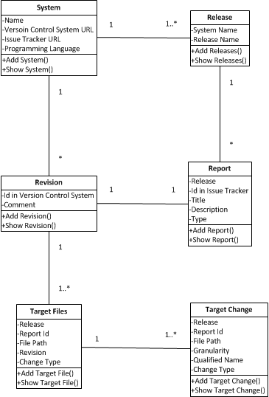
Class Diagram

Slide 3
Where we are at
Edited our previous page flow model to give a clearer view of how the website should work
Pulled all existing html and css from the legacy website to use as a starting template
Setup development environments (IntelliJ, Apache Tomcat)
Setup Github accounts
Did research for using the Spring framework for the login and functions for pages.

Slide 4
Things to do
Next Iteration 10/22-10/28:
Implement the remaining models: Releases, Reports, etc. -Donald
Create UI of the pages for Users (HTML,CSS/Twitter Bootstrap) based off of the current template –Amber
Create the MySQL Database with the table relationships defined in our revised domain model. Help with persistence of model attributes to the database tables.
-Raymond
Work on creating a login page to give full access to the repository to only the Admin and Trusted Users -Matt

Slide 5
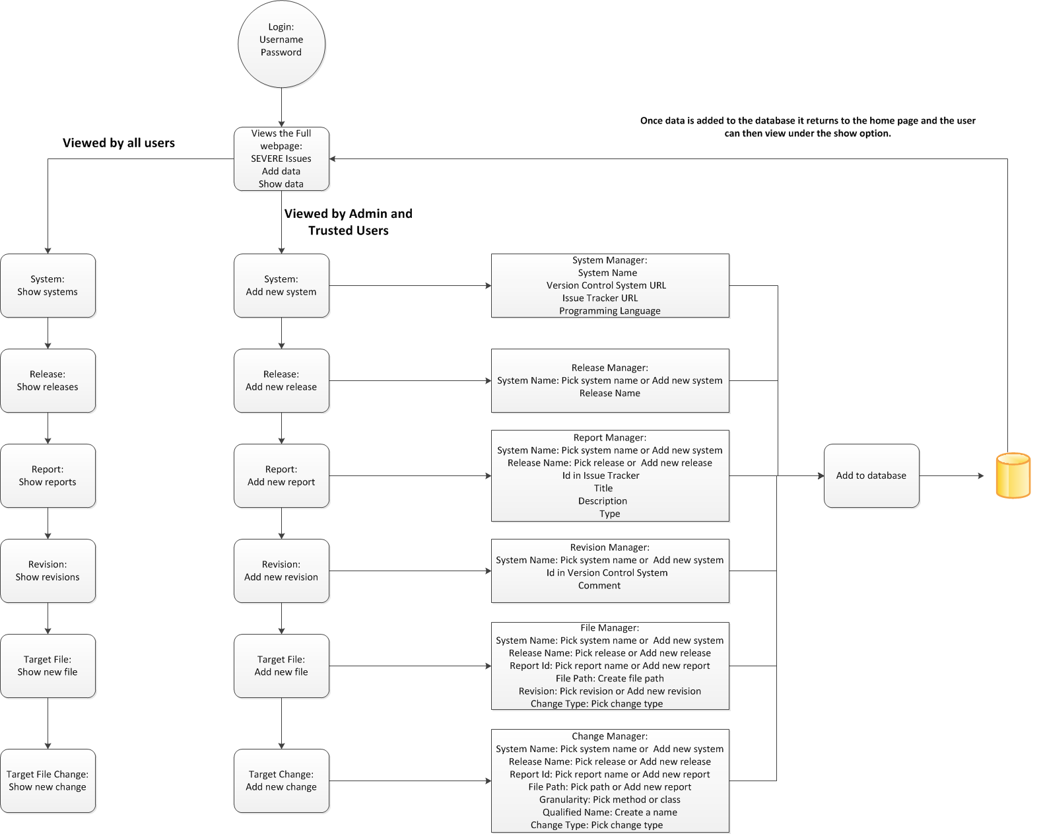
Data Flow Diagram

Slide 6
Resources:
Bootstrap
http://getbootstrap.com/
DesignDocuments/JavaTutorials:
http://www.youtube.com/user/derekbanas/videos?view=1&flow=grid
Spring, Hibernate, Spring MVC:
http://www.youtube.com/user/koushks/videos?view=1&flow=grid
HTML,CSS3,JavaScript:
http://thenewboston.org/tutorials.php

